Slide 1
Recommendation Engine
Technical Report by Elke Hansen

Slide 2
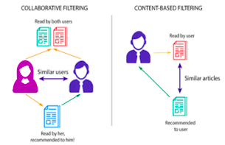
Recommendation Engine Recap
● Collaborative Filtering:
Needs a large amount of data per customer
● Content-based Filtering:
Needs large amounts of product based data
Start with collaborative and see what I can get

Slide 3
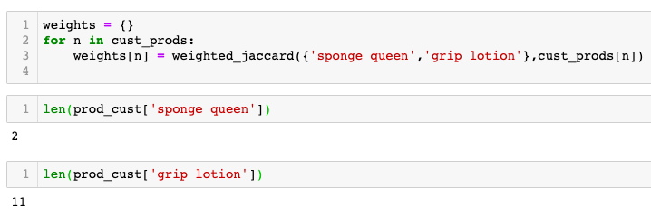

Weighted Jaccard
Finds the similarity between two sets
Takes the jaccard distance:
sum(A ∩ B)/sum(A ∪ B)
Weights it by the cardinality of each item
Notes:
Sum of intersection divided by sum of union

Slide 4
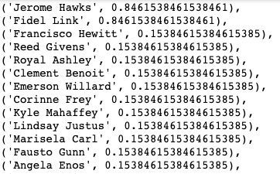
Basics of Recommendation Using Jaccard
Recommend
Calculates Jaccard similarity of the
products customer has purchased
and all other customers
Sort by the highest weights and select
highest 5
What about if you don’t have enough
customer history or they are brand new customer?
Content-based filtering!

Slide 5
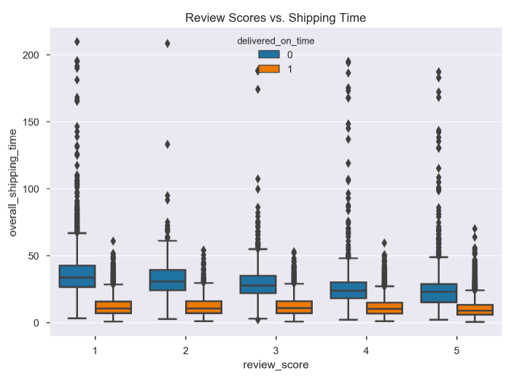
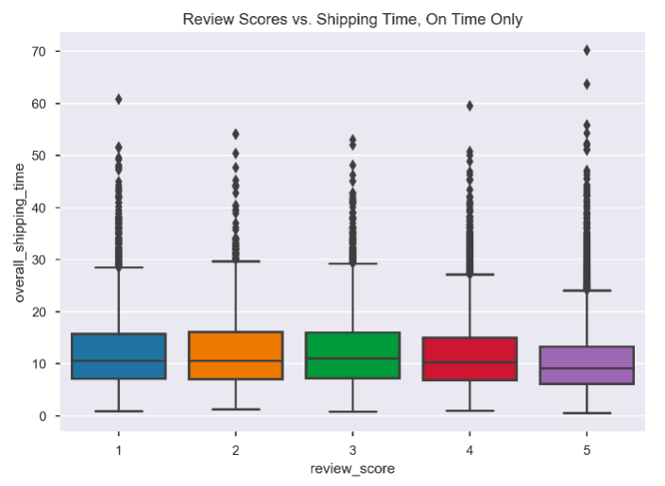
A Closer Look at Review Score & Delivery

Slide 6
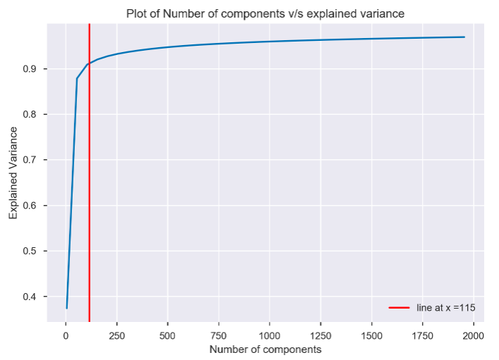
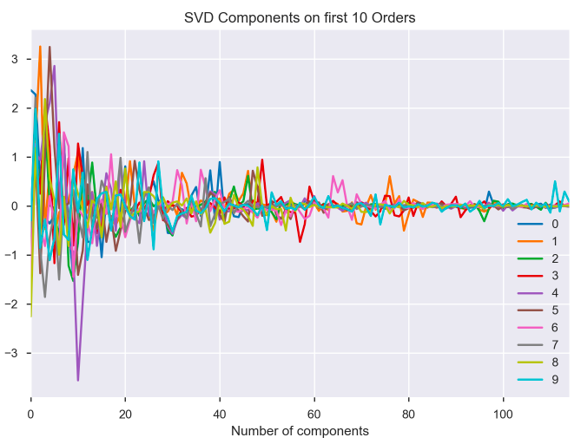
Truncated SVD
Separated features into two training/testing sets for predicting Review Score and On Time Status
Plotted number of components for Truncated SVD versus explained variance for both
Ideal number of component 115 for both

Slide 7

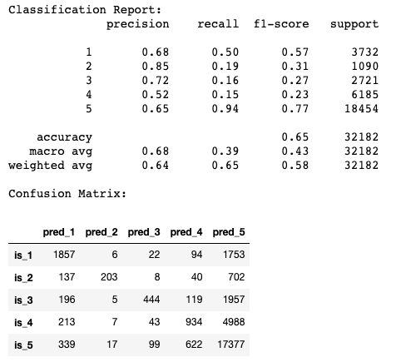
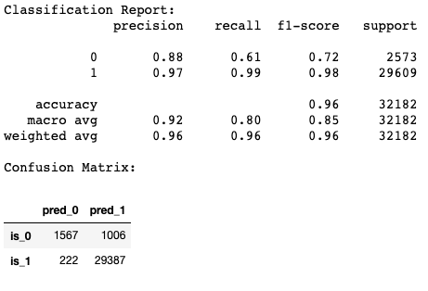
Model
Review Score On Time Status

Slide 8
Where We’re At
Basic recommender → good for old customers
New customers → More complicated
As you get more information about customer, transition from content based to collaborative

Slide 9
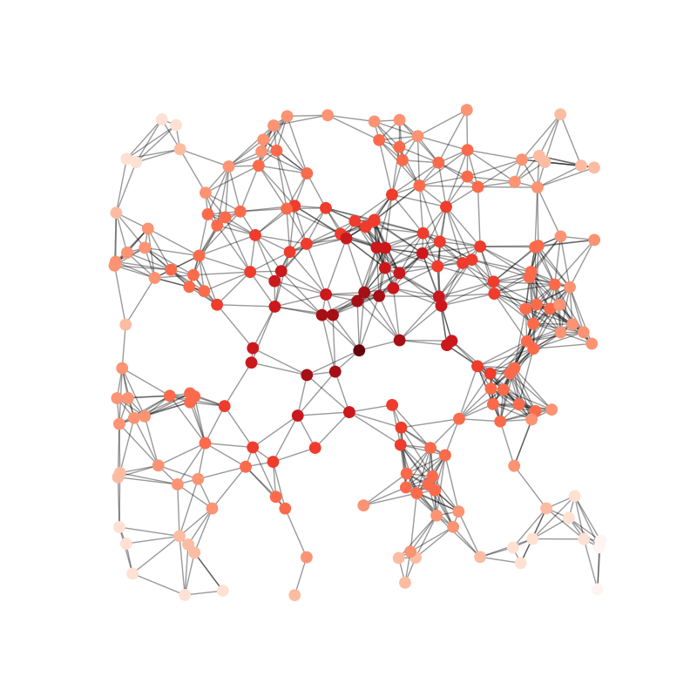
What’s Next?
Properly combine models for end to end model flow
Creation of a Network Diagram
Application for showcasing working model

